Slide 1
Project
Elements of Computing Systems

Slide 2
1.
1.
Implementation Agenda
2.
2.
3.
3.
String Library in JACK
Assembler
Dumping in RAM.hdl

Slide 3
I’am Going to Implement the following String library functions in Jack
Constructs a new empty string with a maximum length
Returns the character value at the specified index.
Returns the length of this string
De-allocates the string and frees its memory space.

Slide 4
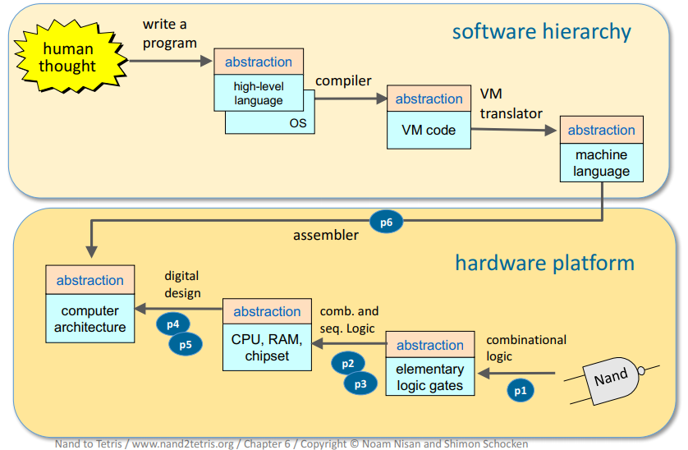
The Big Picture

Slide 5
JACK
Jack is a simple object-based language.
It has the basic features and flavor of modern languages like Java and C#, with a much simpler syntax and no support for inheritance.
The programmer can write the instructions easily in High Level Language like Jack and it can be compiled using Jack Compiler.

Slide 6
String Library Implementation

Slide 7
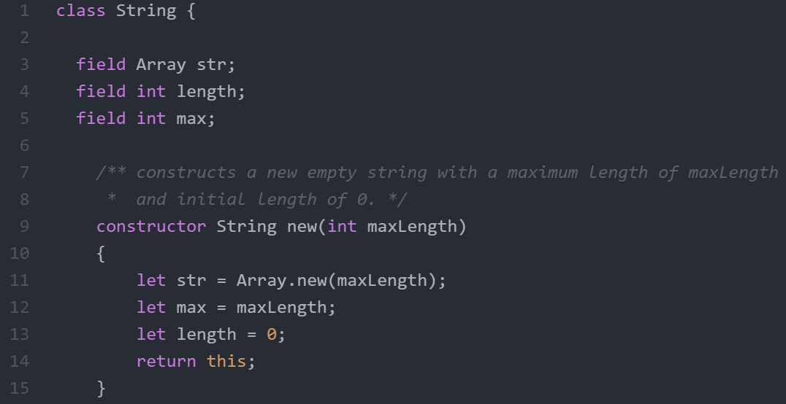
String Library Implementation
First a constructor is created to create the String Array.
Constructor is called whenever an object of String Class is created

Slide 8
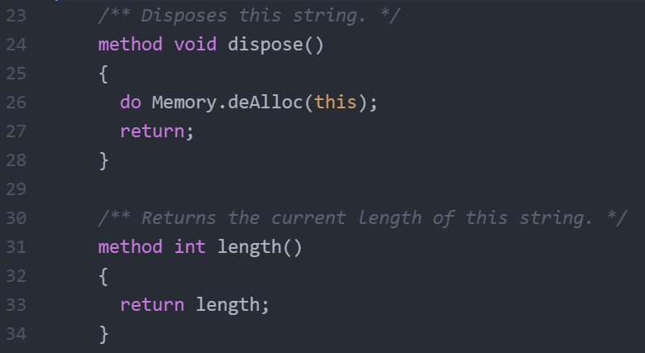
Dispose method is created and the command Memory.deAlloc is used to dispose the object from the RAM.

Slide 9
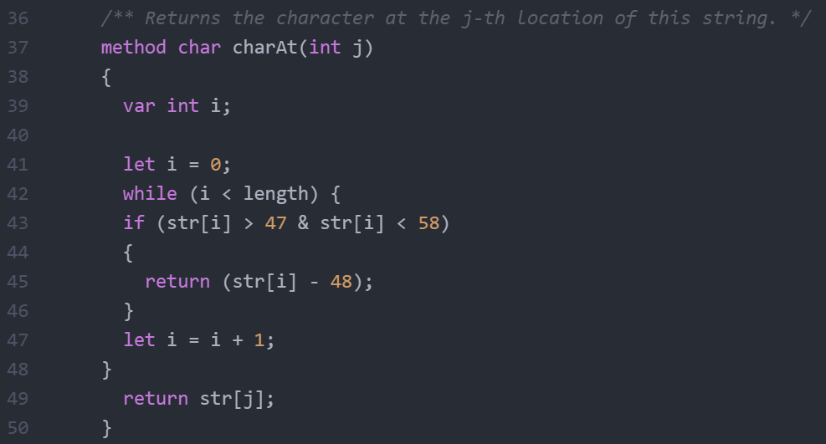
charAt() method to search entirely through the String Array and print the character at that location.
If the character is a number, it is represented in it’s ASCII value.
If it’s not, that character itself is printed.

Slide 10
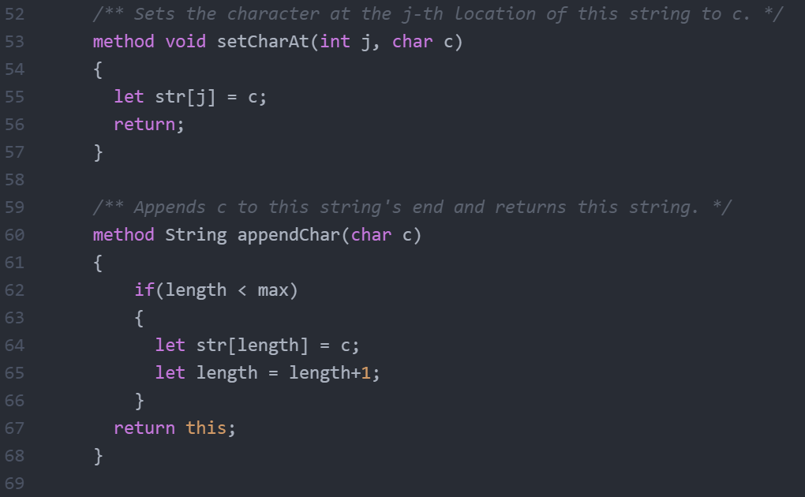

Slide 11
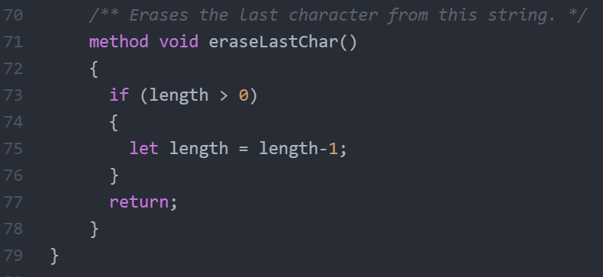
eraseLastChar() removes the last element and makes it null.
Then it decreases the current Length of the Array by 1.

Slide 12
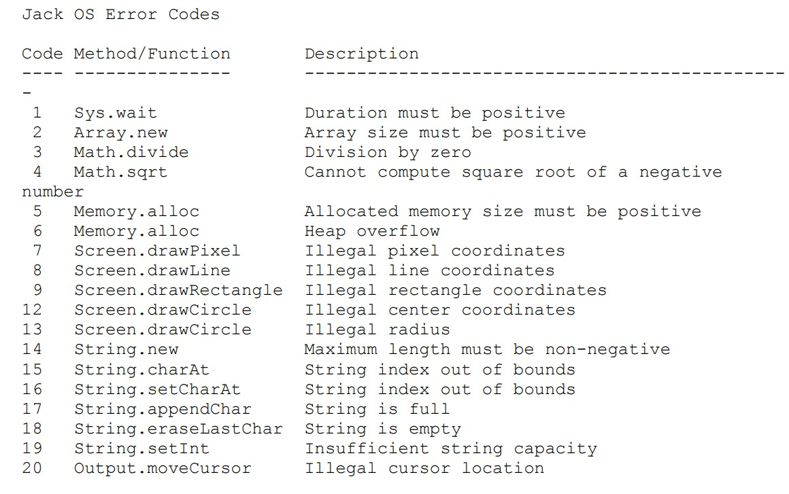
JACK OS Error Codes

Slide 13
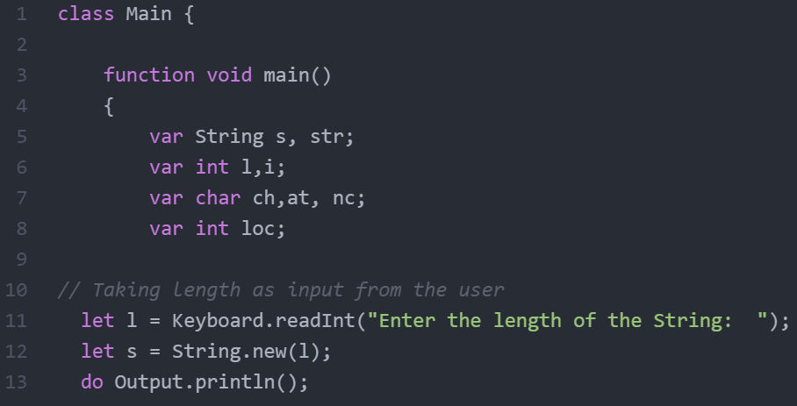
Main file Implementation

Slide 14
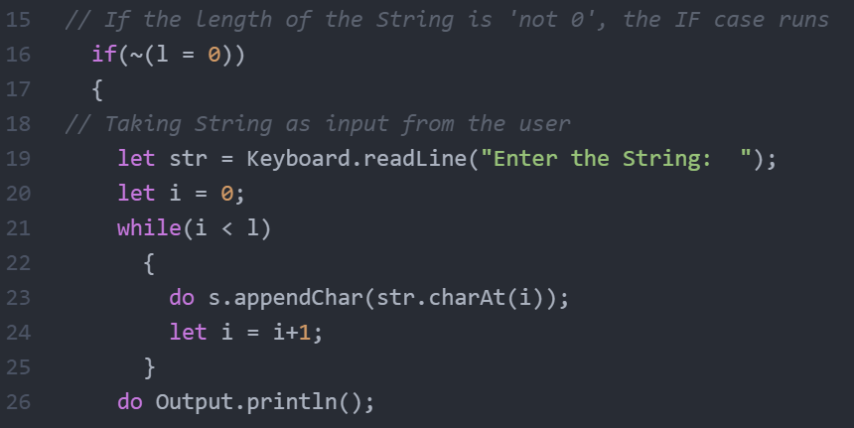
Taking the String input from the user

Slide 15
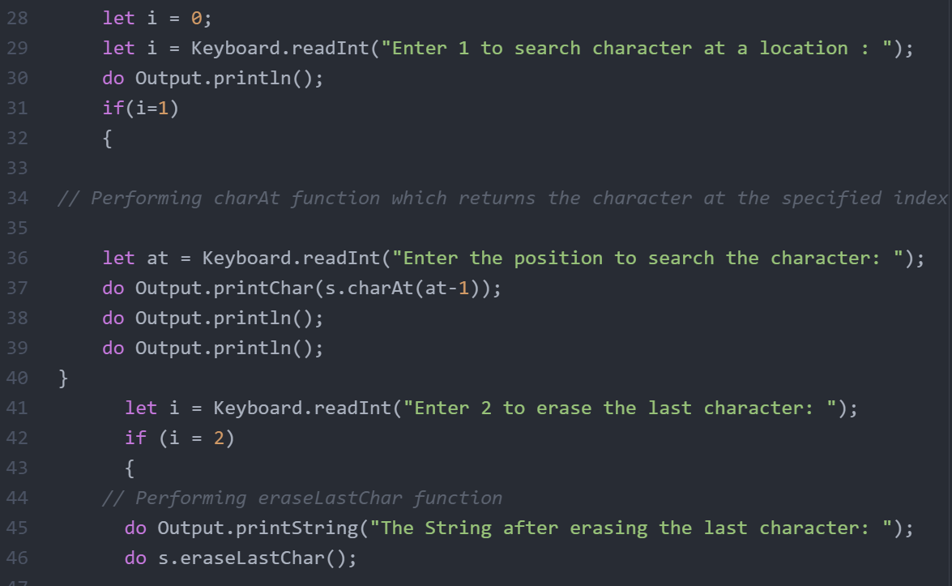
charAt()
User is given a choice to choose if charAt() option need to be performed.
If the user choose option as 1, charAt will be performed or else the code moves on.

Slide 16
eraseLastChar()
Moving on,
If the user choose option as 2, eraseLastChar option is performed.

Slide 17
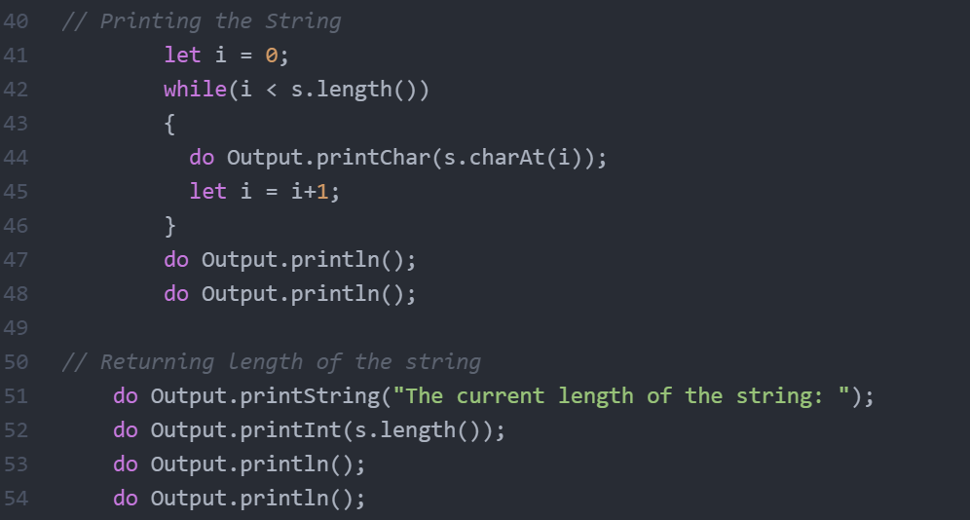
Printing the String after operations and returning it’s current Length

Slide 18
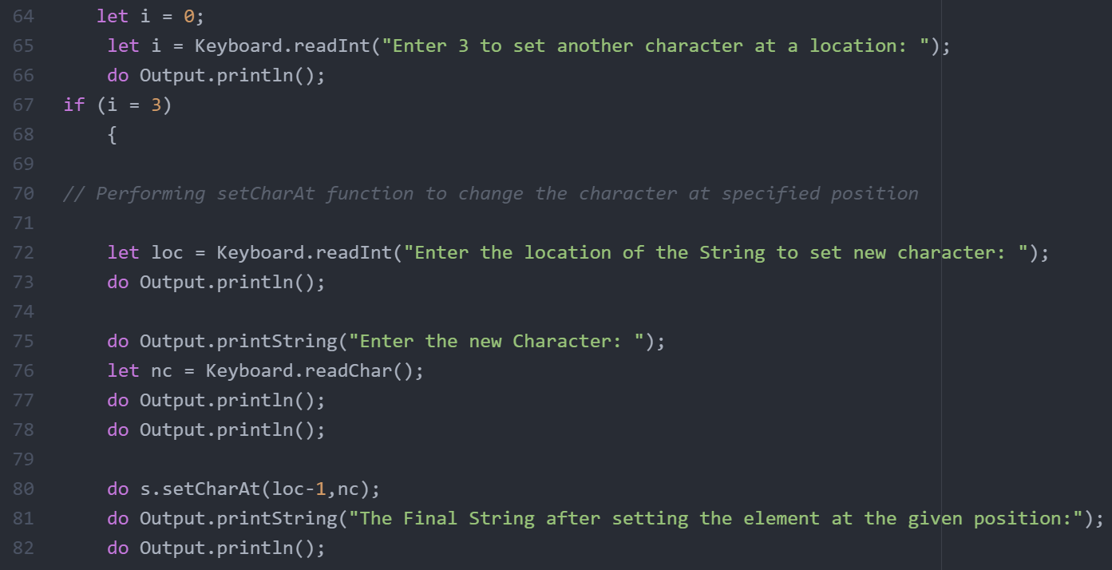
setCharAt

Slide 19
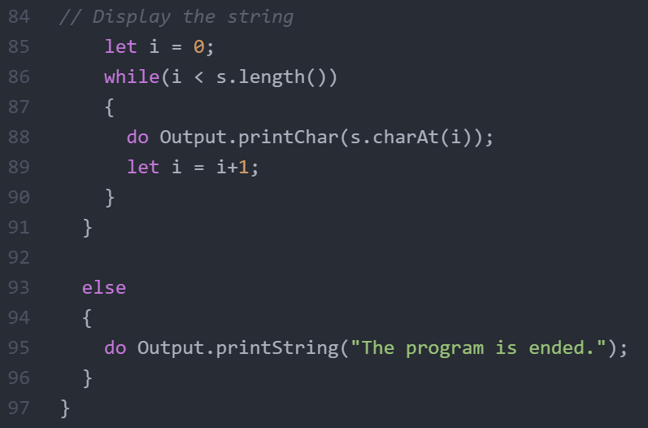
If the user doesn’t choose any option, the program goes to the else case.

Slide 20
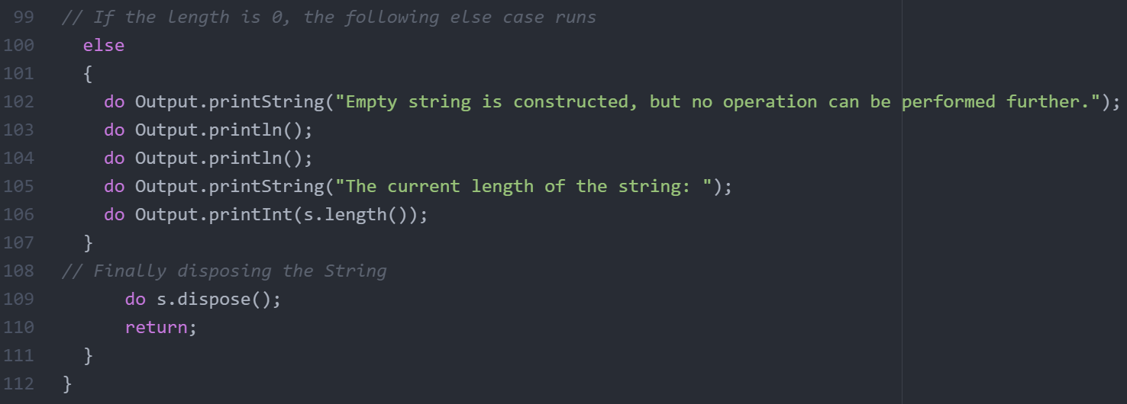
If the Length specified by user is 0 following message is printed:
Dispose() function is called to dispose off the string and deallocate it from Memory.

Slide 21
VM Code

Slide 22
VM code
VM code: the VM language consists of arithmetic, memory access, programflow, and subroutine calling operations. Which deals with stack operations.
all operations are done on a stack. It is also function-based. Each function has its own stand-alone code and is separately handled. The VM language has a single 16-bit data type that can be used as an integer, a Boolean, or a pointer.
The language consists of four types of commands:
Arithmetic commands: perform arithmetic and logical operations on the stack.
Memory access commands: transfer data between the stack and virtual memory segments.
Program flow commands: facilitate conditional and unconditional branching operations.
Function calling commands: call functions and return from them.

Slide 23
VM emulator: Once a high-level program is compiled into VM code, the program can run on any hardware platform equipped with a suitable VM implementation. In this chapter we start building the VM implementation on the Hack platform and use a VM emulator.
VM Translator: used to translate High-level language to low-level language, from VM code to assembly code.

Slide 24
Assembler

Slide 25
What is an Assembler. ?
The Assembler is a Software that converts an assembly language code to machine code.
It takes basic Computer commands and converts them into Binary Code that Computer’s Processor can use to perform its Basic Operations.
An assembler is simple translator which Handles symbols ( i, sum, LOOP, END, …)

Slide 26
A translator’s perspective
Assembly program elements:
White space - Empty lines / indentation - Linecomments - In-line comments
Instructions - A-instructions - C-instructions
Symbols - References - Label declarations

Slide 27
Symbols
Symbol | Value | Symbol | Value
R0 | 0 | SP | 0
R1 | 1 | LCL | 1
R2 | 2 | ARG | 2
... | ... | THIS | 3
R15 | 15 | THAT | 4
SCREEN | 16384
KBD | 24576
Pre-defined symbols:
Label declaration:
(label)
Variable declaration:
@variableName

Slide 28
Types Of Instructions
A-INSTRUCTION
Symbolic syntax:
@ value
Where value is either
a non-negative decimal constant or
a symbol referring to such a constant
0 valueInBinary
Binary syntax:

Slide 29
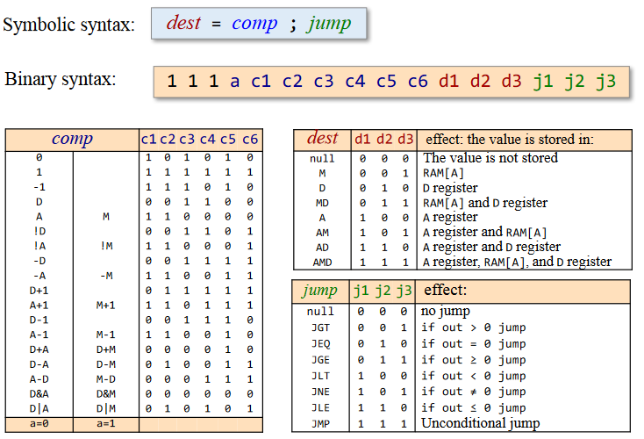
C-INSTRUCTION

Slide 30
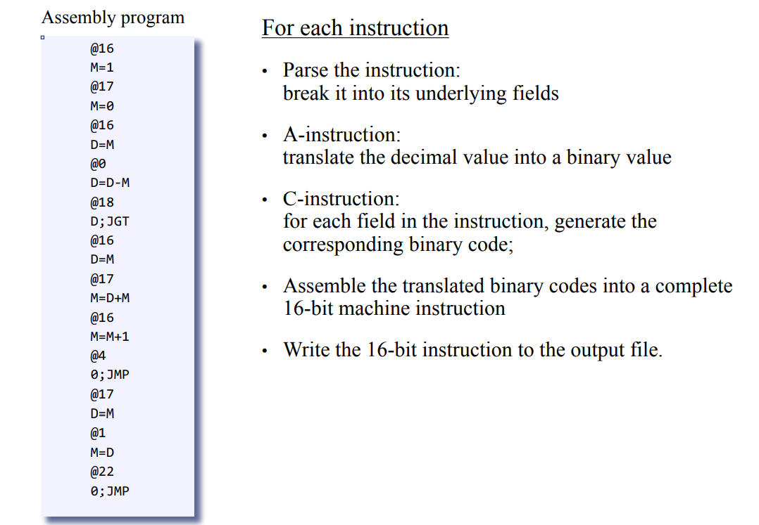
The Overall Assembler Logic

Slide 31
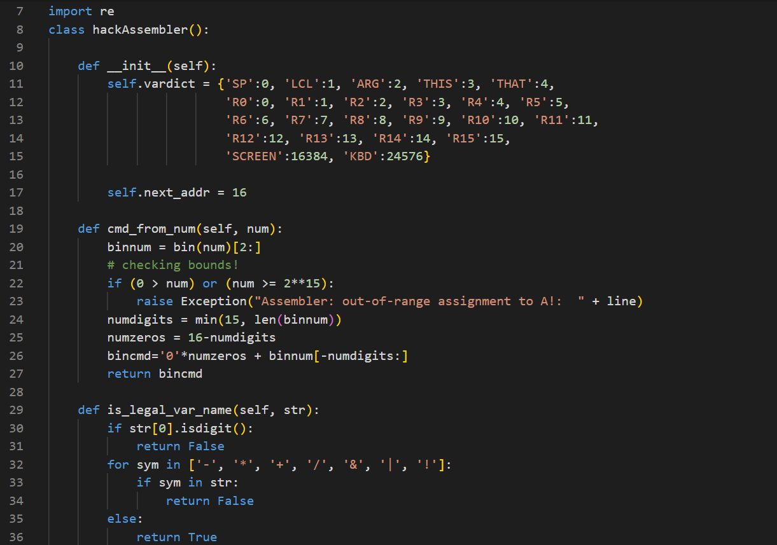
Assembler.PY
A regular expression specifies a set of strings that matches it .
Later we created some constructers(def__init__(self),cmd_from_num,…) these constructer basically contains objects, and the function of this object if call the function,in the first constructor it reads different types of symbols and convert them into the binary code

Slide 32
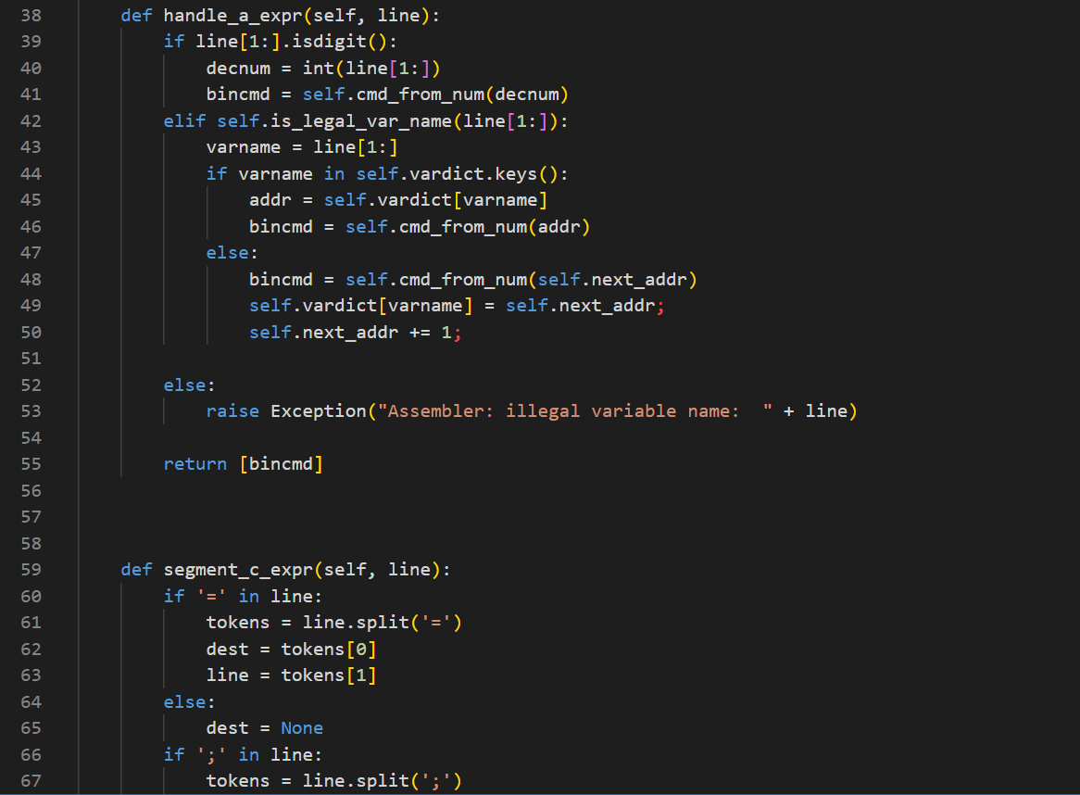
Here, we just created another two constructors namely hadle_a_expr used for handling different variables, Next we used the constructor segment_c_expr for using different symbols and self is used to for accessing the different instance of the variables with in the class itself.

Slide 33
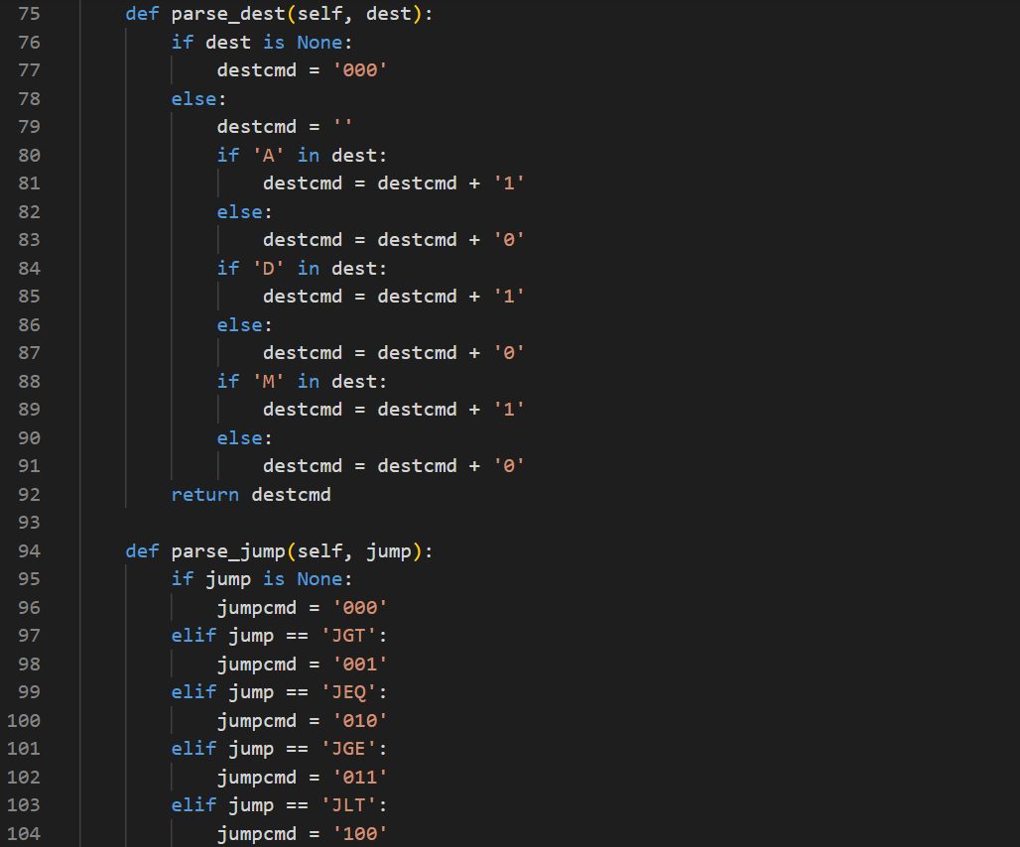
As we know assembler reads two types of instruction A and C , firstly coming to the C-instruction, coming to the destination(dest), According the type of input the c-instruction reads and convert into binary code.
Next, we have used the jump constructor, Simillarly according to the type of symbolic syntax the binary code is generated.

Slide 34
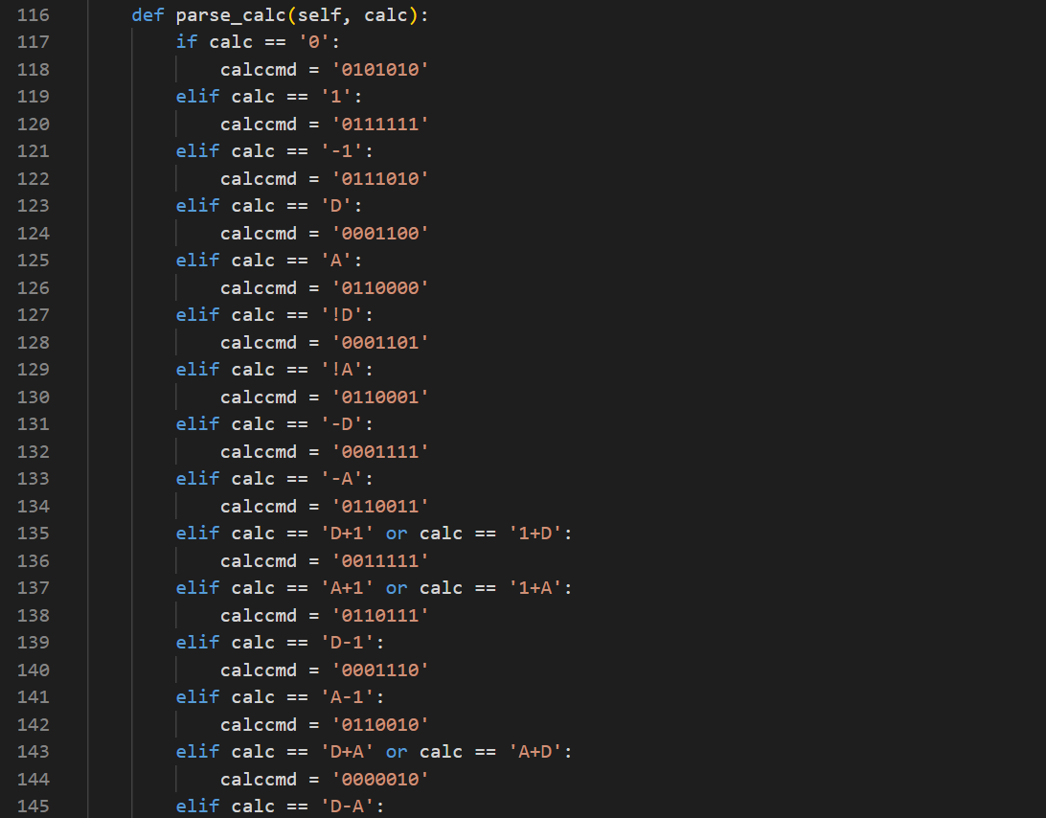
Now, we created another constructor for giving different dest instructions.

Slide 35
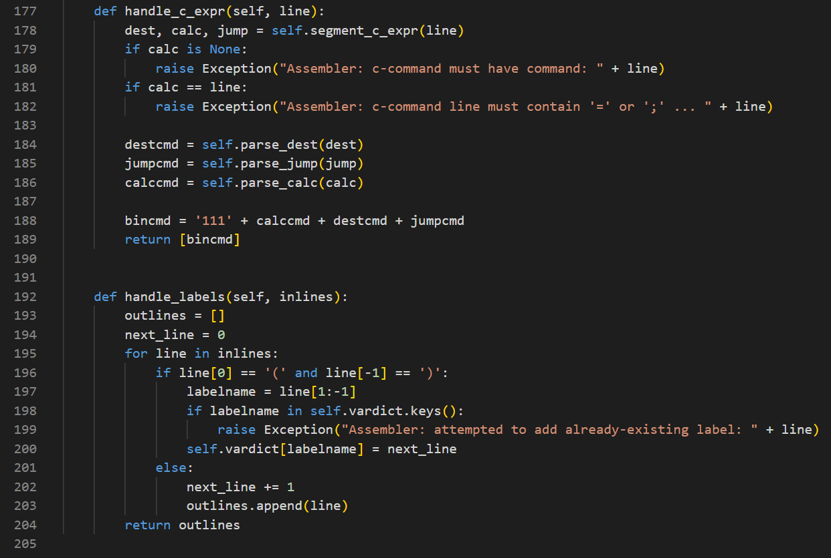

Slide 36
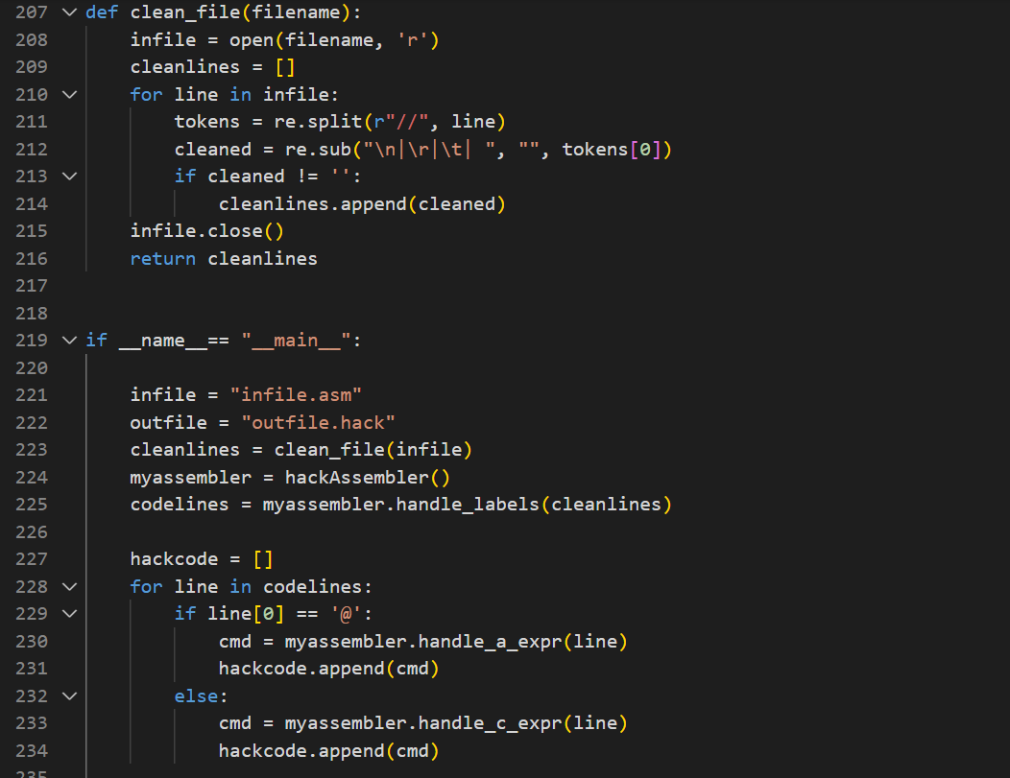
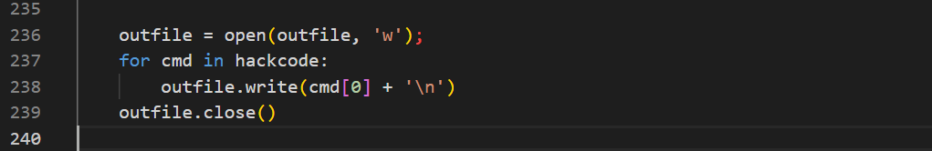
Finally, we recall all the objects and when ever we give an input file the name is set to main by default by using that condition, we give the infile as .asm and outfile name is set to .hack and finally the assembly code is converted into binary

Slide 37
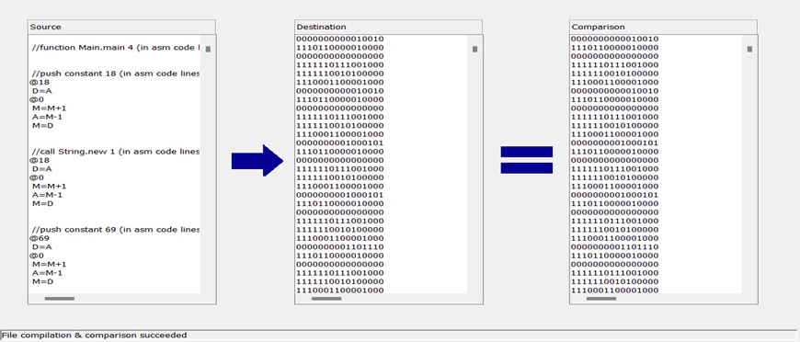
Comparing .hack files

Slide 38
PART - 3
Dump the machine codes generated by your own assembler into the RAM.hdl. Then design the architecture for implementing your machine instructions to get the result.

Slide 39
HARDWARE SIMULATOR
Software simulation is often used when evaluating computer systems. It may, however, be time consuming and expensive, especially when many runs with slightly differing parameters have to be done or when small changes in the model have to be performed frequently. In such situations, and when not too much detail and only small amounts of output data are required, the hardware simulator described in this paper may be an effective tool. The hardware simulator is an apparatus on which physical models of computer systems can be built.

Slide 40
CHIP Computer { IN reset; PARTS: ROM32K(address=pc,out=instruction); CPU(inM=inM,instruction=instruction,reset=reset,outM=outM, writeM=writeM,addressM=addressM,pc=pc); Memory(in=outM,load=writeM,address=addressM,out=inM); }
To run the machine codes generated by our own assembler in the RAM.hdl, we need to run the Computer.hdl program.
Computer.hdl
To run the computer.hdl program in hardware simulator we need the hdl codes of CPU and Memory

Slide 41
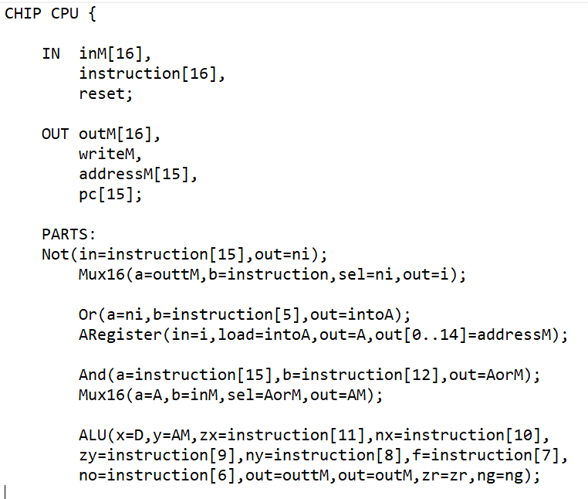
CPU.hdl

Slide 42
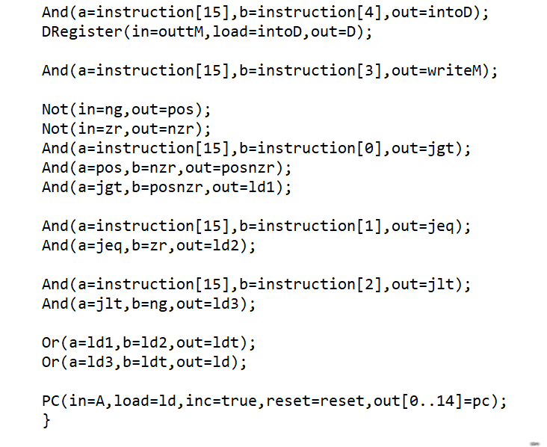

Slide 43
Memory.hdl
CHIP Memory {
IN in[16], load, address[15];
OUT out[16];
PARTS:
DMux4Way(in=load, sel=address[13..14], a=loadram1, b=loadram2, c=loadscreen, d=loadkbd);
Or(a=loadram1, b=loadram2, out=loadram);
RAM16K(in=in, load=loadram, address=address[0..13], out=ramout);
Screen(in=in, load=loadscreen, address=address[0..12], out=scrout);
Keyboard(out=kbout);
Mux4Way16(a=ramout, b=ramout, c=scrout, d=kbout, sel=address[13..14], out=out);
}

Slide 44
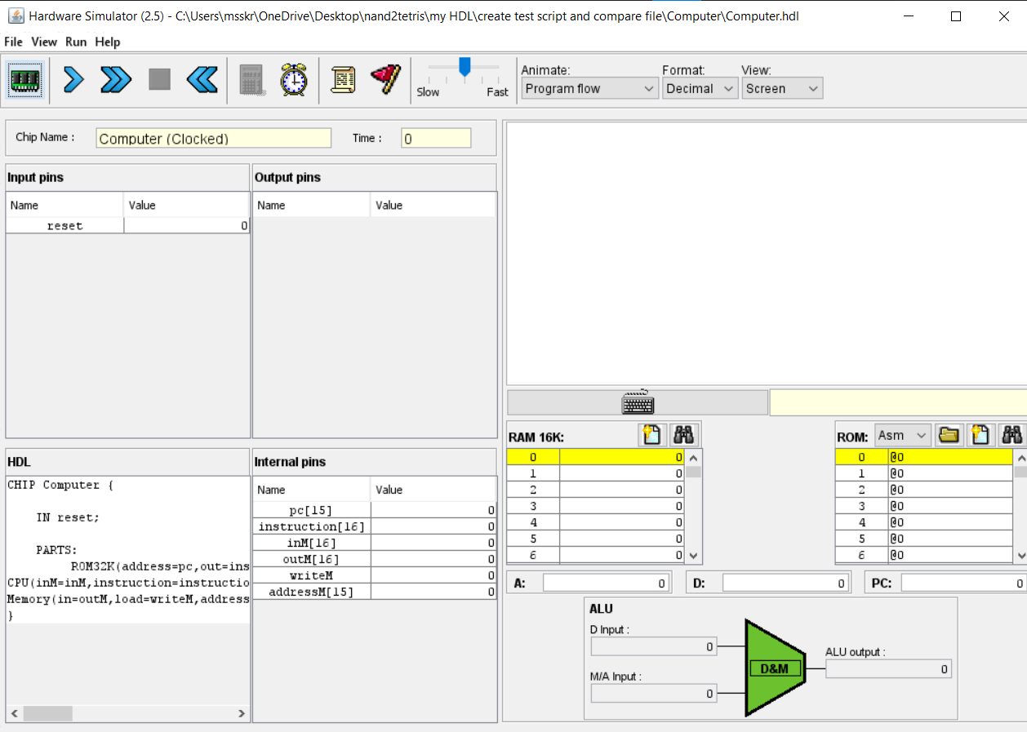
Loading the Computer.hdl in Hardware Simulator

Slide 45
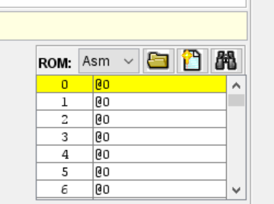
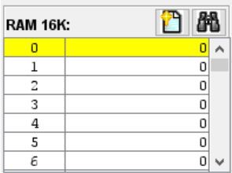
After loading the computer.hdl in hardware simulator, below the screen RAM and ROM parts will appear, because the computer is made up of Memory and CPU.
In the ROM we need to provide the hack file. By running the code it will only read the file and we will get the required binary part in the RAM.

Slide 46
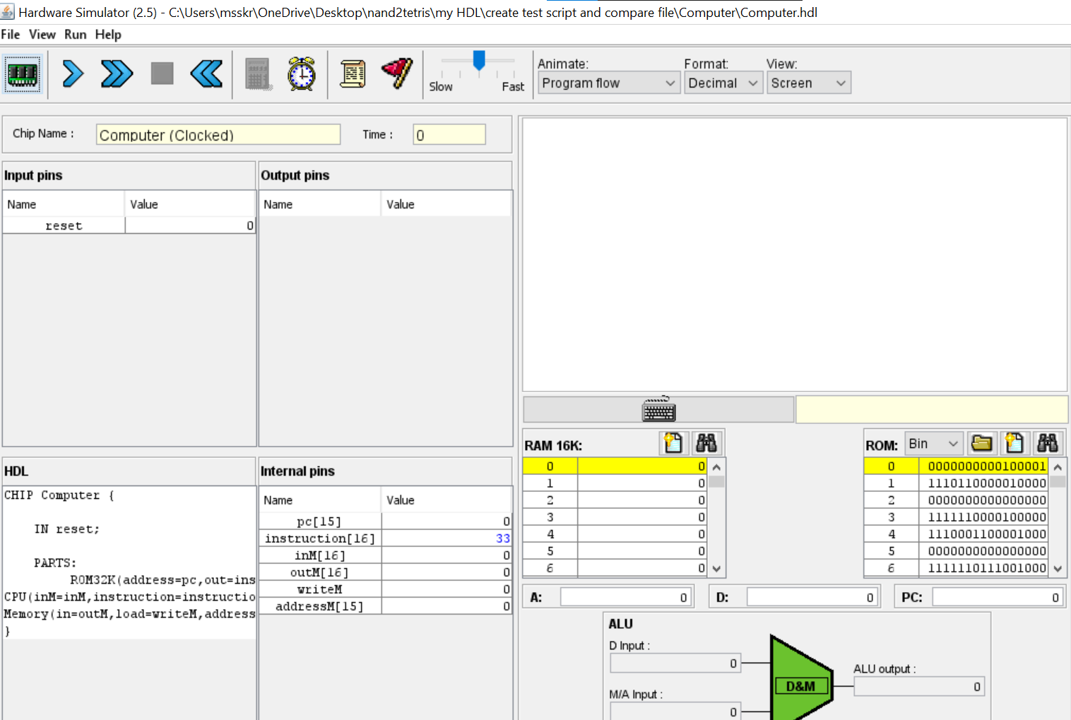
After loading the hack file in ROM

Slide 47
HACK File
0000000000100001
1110110000010000
0000000000000000
1111110000100000
1110001100001000
0000000000000000
1111110111001000
0000000001000101
1110110000010000
0000000000000000
1111110000100000
1110001100001000
0000000000000000
1111110111001000
0000000001101110
1110110000010000
0000000000000000
1111110000100000
1110001100001000
0000000000000000
1111110111001000
0000000001110100
1110110000010000
0000000000000000
1111110000100000
1110001100001000
0000000000000000
1111110111001000
0000000001100101
1110110000010000
0000000000000000
1111110000100000
1110001100001000
0000000000000000
1111110111001000
0000000001110010
1110110000010000
0000000000000000
1111110000100000
1110001100001000
0000000000000000
1111110111001000
0000000000100000
1110110000010000
0000000000000000
1111110000100000
1110001100001000
0000000000000000
1111110111001000
0000000001110100
1110110000010000
0000000000000000
1111110000100000
1110001100001000
0000000000000000
1111110111001000
0000000001101000
1110110000010000
0000000000000000
1111110000100000
1110001100001000
0000000000000000
1111110111001000
0000000001100101
1110110000010000
0000000000000000
1111110000100000
1110001100001000
0000000000000000
1111110111001000
0000000000100000
1110110000010000
0000000000000000
1111110000100000
1110001100001000
0000000000000000
1111110111001000
0000000001101100
1110110000010000
0000000000000000
1111110000100000
1110001100001000
0000000000000000
1111110111001000
0000000001100101
1110110000010000
0000000000000000
1111110000100000
1110001100001000
0000000000000000
1111110111001000
0000000001101110
1110110000010000
0000000000000000
1111110000100000
1110001100001000
0000000000000000
1111110111001000
0000000001100111
1110110000010000

Slide 48
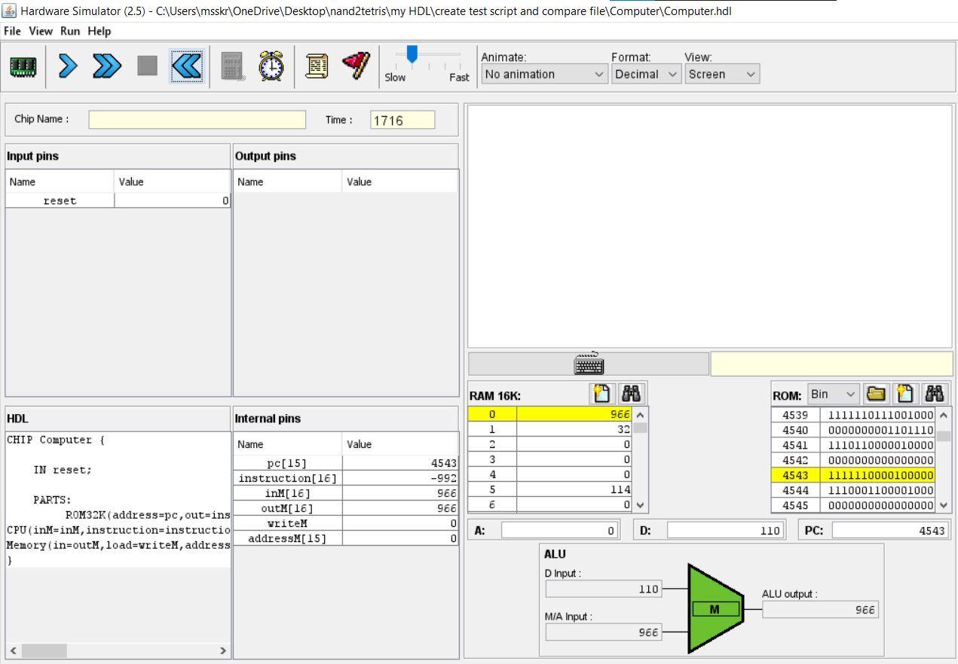
Running the HACK File in Computer.hdl

Slide 49
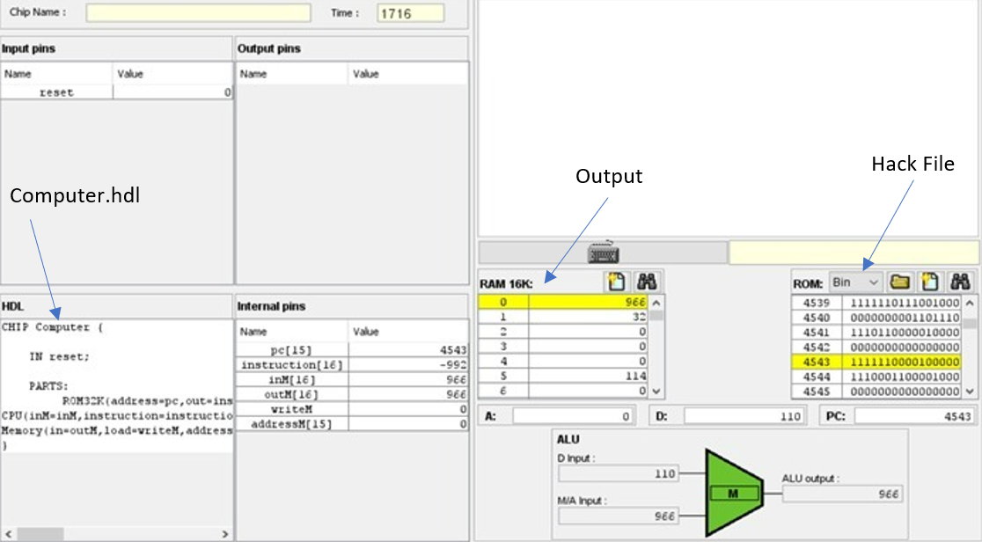
Output

Slide 50
Contribution of group members
JACK
A) Constructor & Appending Char & SetcharAt
- Rahul & Santhosh
B) charAt & eraseLastChar & Length & Dispose
- Srinivas & Venkat
Assembler | Ramisetty Lakshmi Venkat M Sai Rahul
VM Translator & RAM.hdl | M Srinivasa Sai Kumar Reddy Madha Santhosh Kumar Reddy

Slide 51
Thank You

